Slide 1
Jain Pilgrimage Spots in India
Shravanabelagola
Dilwara Temples
Ranakpur Temples
Palitana,
Bawangaja,

Slide 2
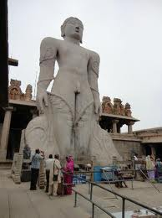
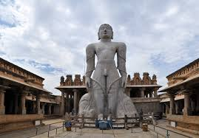
Jain Pilgrimage sites in Karnataka
Shravanabelagola, a monumental statue of Saint Gomateshwar in Hassan Shravanbelagola Shravanbelagola is a great centre for Jain culture. It is situated at a distance of about 100 km from Mysore. Shravanbelagola is famous for its colossal statue of Gomateshwara, who is also referred to as Lord Bahubali. The statue is carved out of monolithic stone and is 17 meter high.

Slide 3
Jain Pilgrimage sites in Rajasthan
Dilwara Temples, complex of white marble Jain temples on Mount Abu, Dilwara Temples, Rajasthan The Dilwara temples are located around Mount Abu, a famous Hill station of Rajasthan. The Dilwara temples date back to the 11th to the 13th century AD and are famous world-wide for spectacular use of marble. The renowned marble temples of Dilwara. They are an awesome blend of simple beauty and wonderful grace. The marble temples have an opulent entranceway

Slide 4
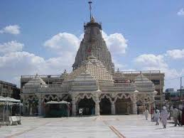
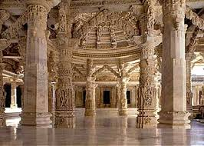
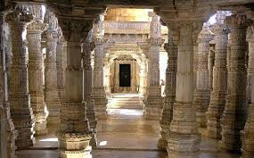
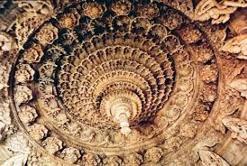
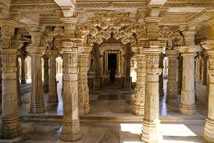

Slide 5
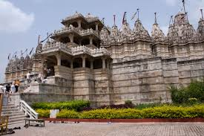
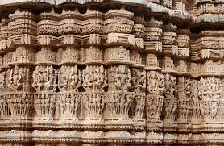
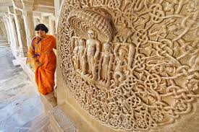
Ranakpur Temples, Rajasthan extensive complex of white marble Jain temples in Ranakpur, It has a 78 cm high copper-colored idol of Mahavir in the Padmasana posture. About 175 km away from Jaipur, it is the most visited temple in Rajasthan, Ranakpur, Ranakpur is located in Rajasthan. It is one of the five most important pilgrimage sites of Jainism. Ranakpur is probably the most extensive of Jain temples in India, covering 40,000 square feet (3600m). The Ranakpur temple can be called a treasure house of pillars. The pillars are arranged in such a manner that none of them obstructs the view of the pilgrims wishing to have a `Darshan' (glimpse). From any corner of the temple one can easily view the Lord's image. It is believed that there are about 1444 pillars in the Ranakpur temple.

Slide 6
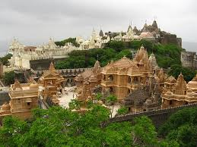
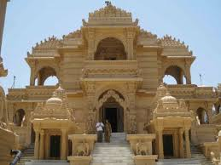
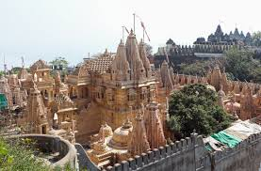
Jain Pilgrimage sites in Gujarat
Palitana, most visited Jain temple in Gujarat,

Slide 7
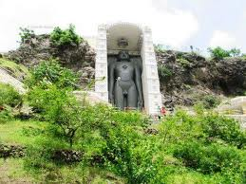
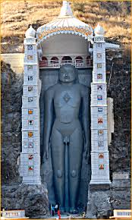
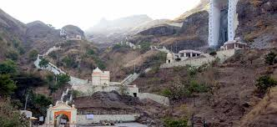
Jain Pilgrimage sites in Madhya Pradesh :
Bawangaja, a complex of Jain temples and monumental statues in Barwani District, Gwalior's fort is home to dozens of Jain rock-cut sculptures.

